Slide 1
Homework 5
By Anh Nguyen, Bryan Strohmeyer, Santiago Ospina, Seth LeMar, and Stephen Peterson

Slide 2
Pre Processing
Rubric: Correctly converted Date to a date format, extracted month, dropped Date and Location, and partitioned the data
#convert date to a date format
weather.df$Date <- as.Date(weather.df$Date , "%m/%d/%Y")
library(lubridate)
weather.df$Month <- as.factor(month(weather.df$Date))
#drop Date and Location variables
weather.df <- weather.df[, -c(1:2)]
#partition the data
train.rows <- sample(rownames(weather.df), nrow(weather.df)*0.6)
train.data <- weather.df[train.rows, ]
valid.rows <- setdiff(rownames(weather.df), train.rows)
valid.data <- weather.df[valid.rows, ]

Slide 3
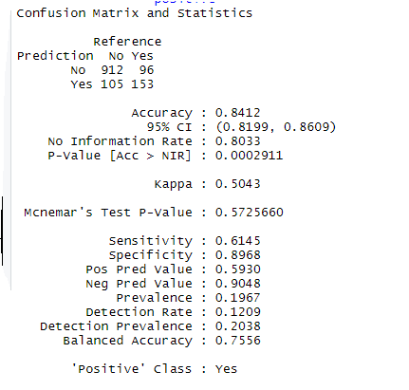
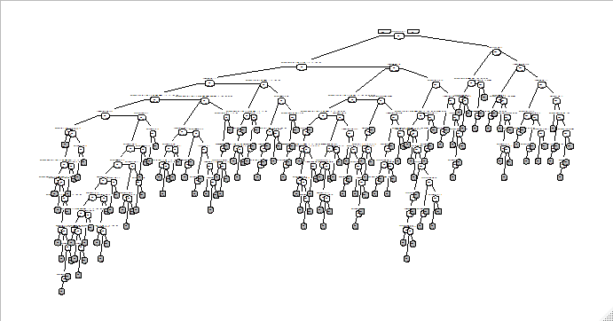
Full Tree and Confusion Matrix
The training model in relation to the validation set has an 84.12% and has 146 leaves

Slide 4
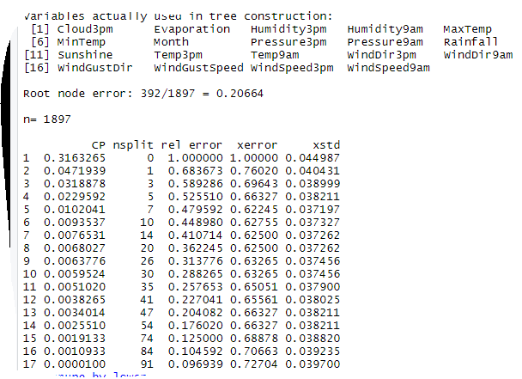
Choosing # of Splits
The number of splits with the lowest estimated cv error is 7, so this is the number we picked for the best pruned tree.

Slide 5
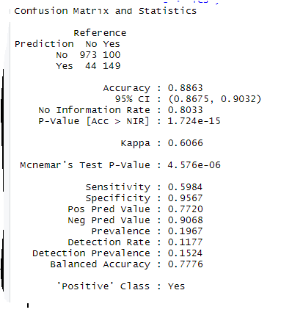
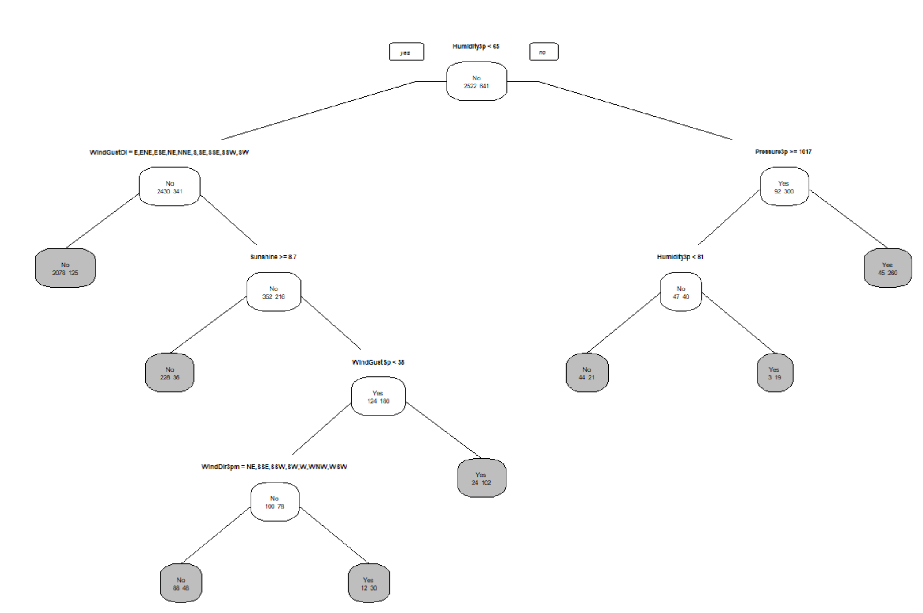
Best Pruned Tree
The best pruned trees accuracy is 88.63% which is less accurate the full tree but is far more simple.

Slide 6
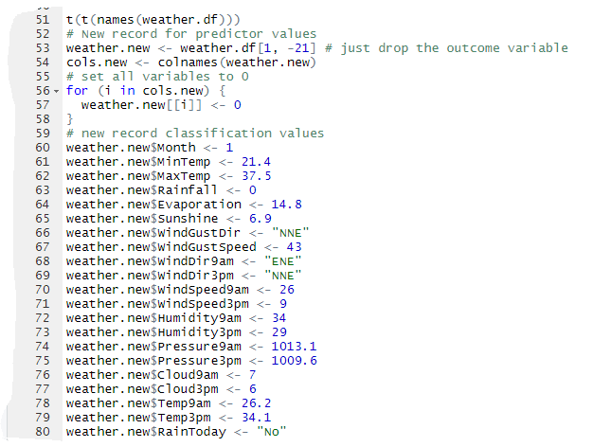
New Record Classification
Rubric: Correctly classified the new record using the best pruned tree and explained how

Slide 7
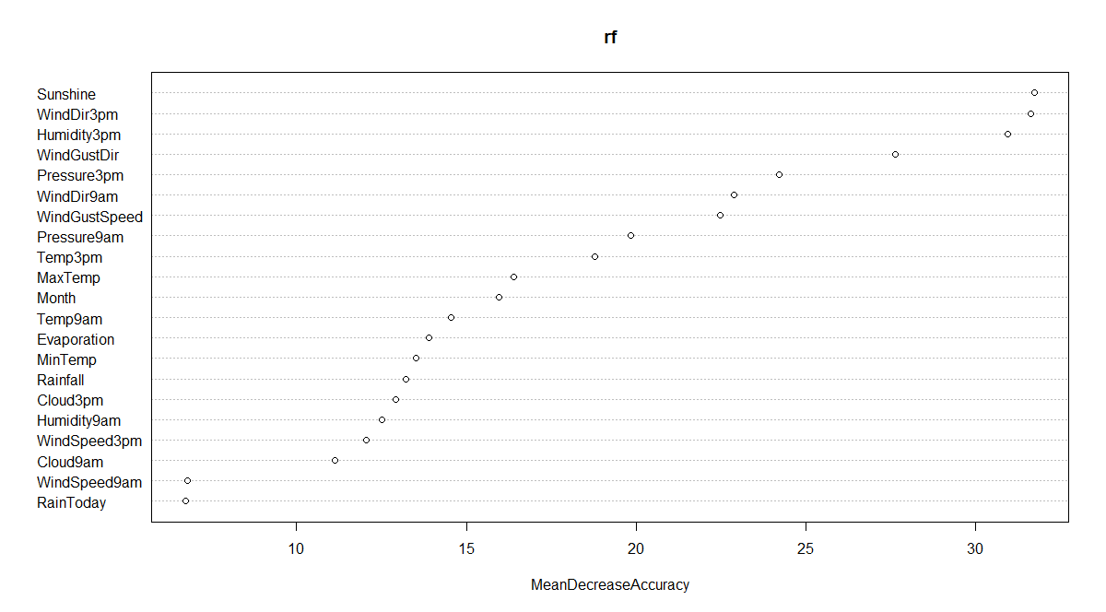
Random Forest Model Variable Importance Plot
Rubric: Correctly created random forest model; Correctly created and interpreted variable importance plot.
Found that the 4 most important predictors are:
Humidity3pm
Sunshine
WindDir3pm
Pressure3pm

Slide 8
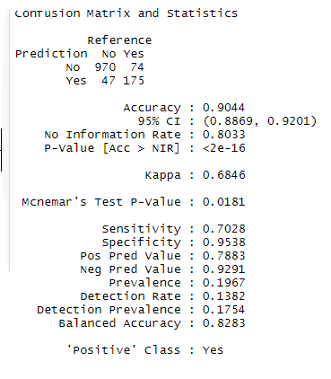
Random Forest Model Confusion Matrix
Correctly created and interpreted confusion matrix
Almost the same as the best pruned tree in terms of accuracy. This one has a 90.44%, only 1.81% higher

Slide 9
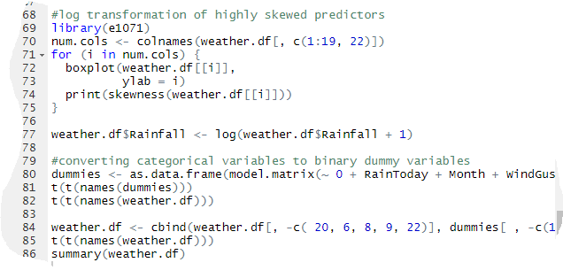
Pre Processing for Neural Nets
Rubric: Correctly pre-processed data for neural nets, to include log-transforming any highly skewed predictors, creating binary dummy variables, and normalizing all predictors to a 0-1 scale

Slide 10
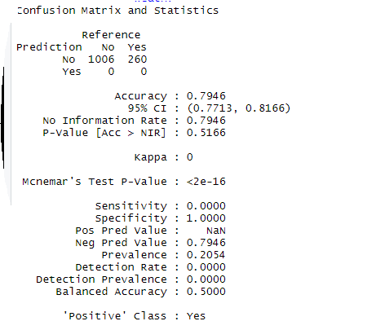
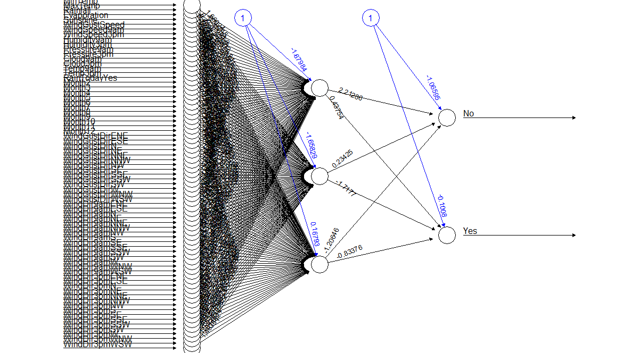
Neural Nets
Neural net with 1 hidden layer and 3 nodes

Slide 11
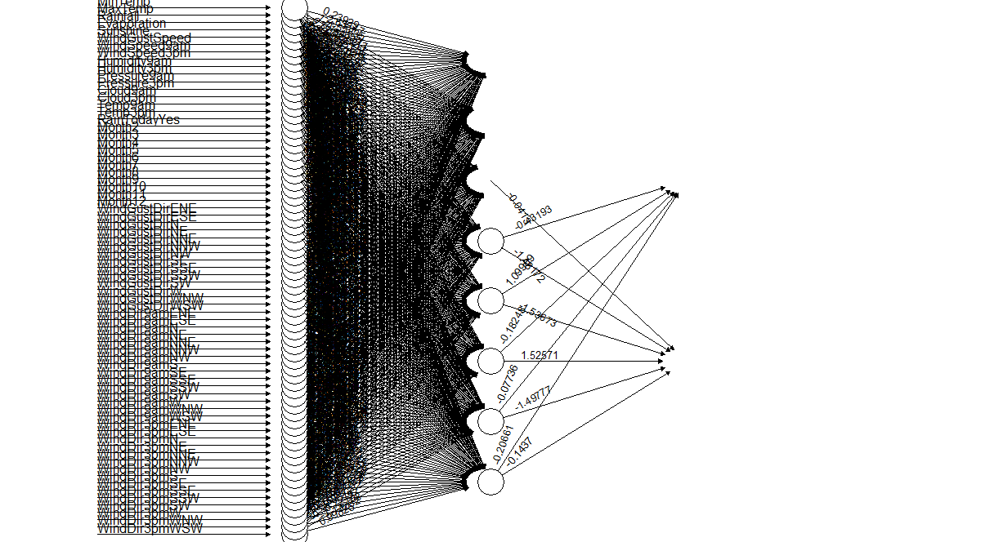
Neural Nets
Neural net with 1 hidden layer and 8 nodes (Somewhat illegible)... Confusion Matrix wouldn’t work

Slide 12
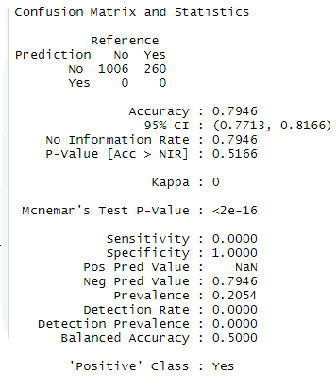
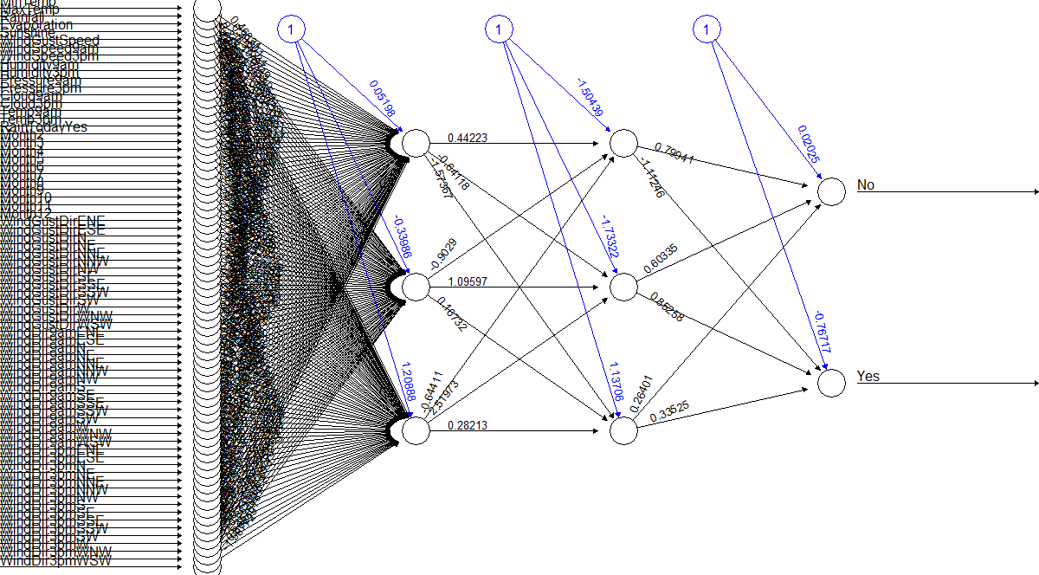
Neural Nets
Neural net with 2 hidden layers and 3 nodes in each

Slide 13
Comparison Table
Rubric: Provided a table correctly comparing the performance of the classification trees, random forest, and neural net models
Model Type | Full Tree | Best Pruned | Random Forest | Neural Net (1 hidden, 3 nodes) | Neural Net (1 hidden, 8 nodes) | Neural Net (2 hidden, 3 nodes)
Accuracy | 84.12% | 88.63% | 90.44% | 79.46% | N/A | 79.46%
Specificity | 89.68% | 95.67% | 95.38% | 100% | N/A | 100%
Sensitivity | 61.45% | 59.84% | 70.28% | 0.0000 | N/A | 0.0000
Precision | 59.3% | 77.2% | 78.83% | 0% | N/A | 0%

Slide 14
Summary
After putting together our table and being able to compare our models (one of ours wasn’t able to load a confusion matrix) We can discard all of our neural nets because accuracy compared to the others is low and all our other confusion matrix measures have unreliable numbers.
If we had to choose from the 3 remaining to predict rain tomorrow, we would choose Random Forest. It has the highest accuracy (at least in our case). It’s numbers are very close with our best pruned tree but beats it in sensitivity and precision. Plus, from a random forest you can produce a variable importance plot which allows you to see what variables are most important or determinant in that forest.

